Slide 1
COT5615: Math for Intelligent Systems I
Anand Rangarajan
Lecture 27

Slide 2
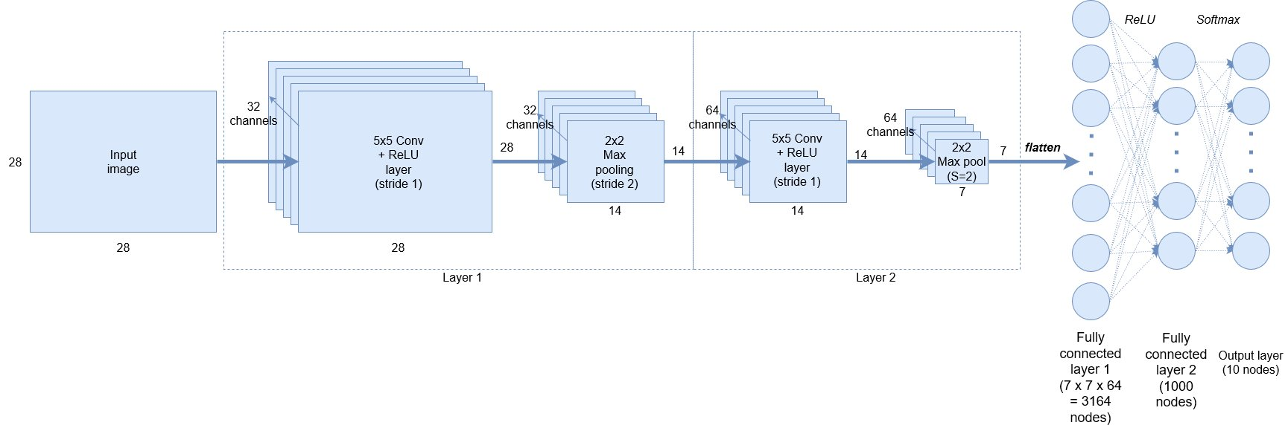
CNN Block Diagram

Slide 3






The XOR problem
$$x_{2}$$
$$(0,1)$$
$$(1,1)$$
o
x
x
o
$$(0,0)$$
$$(1,0)$$
$$x_{1}$$
No Linear Classifier (in 2D)

Slide 4
















The actual feedforward network
$$c_{1}$$
$$+1$$
$$+1$$
$$b$$
$$c_{2}$$
$$W_{11}$$
$$w_{1}$$
$$x_{1}$$
$$h_{1}$$
$$y$$
$$W_{21}$$
$$W_{12}$$
Biases not shown in book
Platforms usually add bias nodes silently
$$x_{2}$$
$$h_{2}$$
$$w_{2}$$
$$W_{22}$$

Slide 5
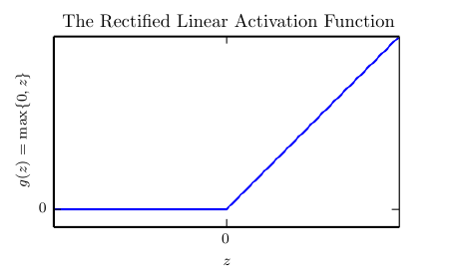

Rectified Linear Unit (ReLU)
$$g\left(z\right)=\max\left\{0,z\right\}$$
Many other activation functions

Slide 6
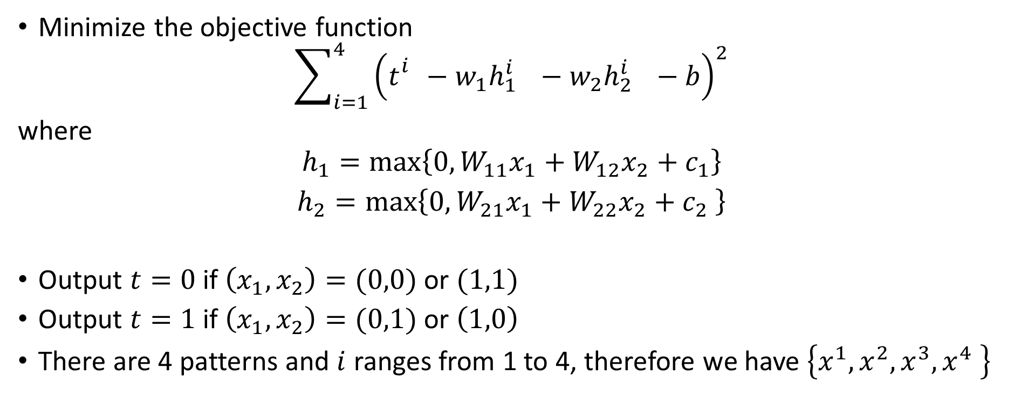
Solution to XOR
Minimize the objective function
$$\sum_{i=1}^{4}{{\left(t_{}^{i}−w_{1}h_{1_{}}^{i}−w_{2}h_{2_{}}^{i}−b\right)}^{2}}$$
where
$$h_{1}=\max\left\{0,W_{11}x_{1}+W_{12}x_{2}+c_{1}\right\}$$
$h_{2}=\max\left\{0,W_{21}x_{1}+W_{22}x_{2}+c_{2} \right\}$
Output $t=0$ if $\left(x_{1},x_{2}\right)=(0,0)$ or $(1,1)$
Output $t=1$ if $\left(x_{1},x_{2}\right)=(0,1)$ or $\left(1,0\right)$
There are 4 patterns and $i$ ranges from 1 to 4, therefore we have $\left\{x^{1},x^{2},x^{3},x^{4} \right\}$

Slide 7
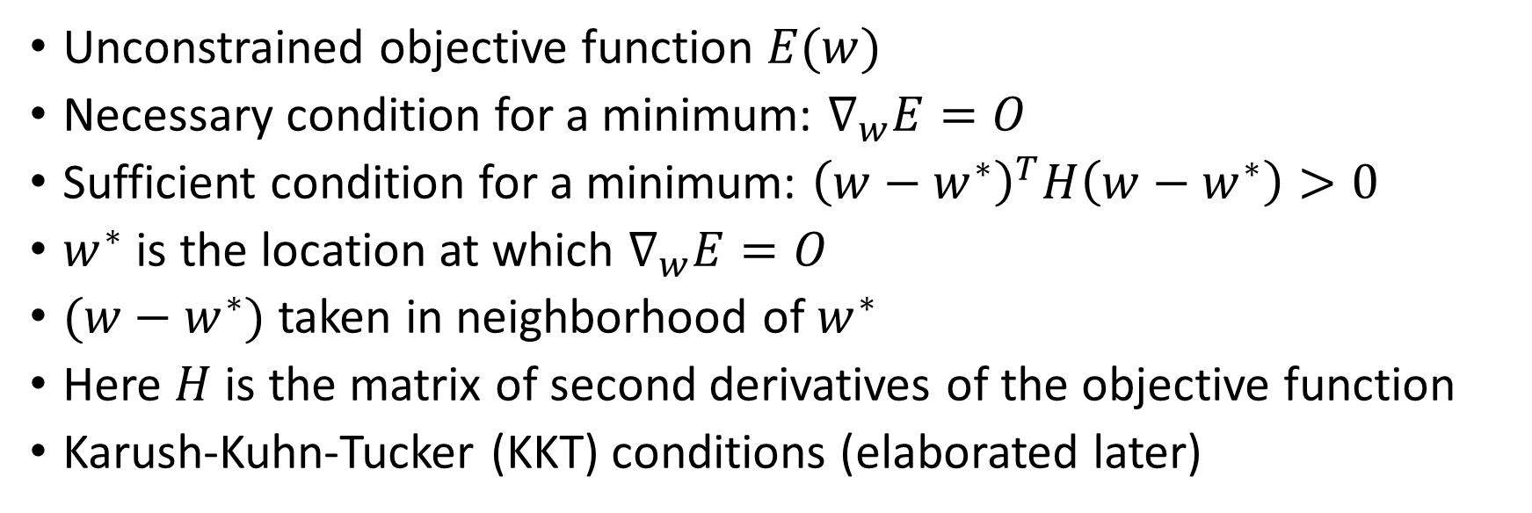
Minimizing the error measure
Unconstrained objective function $E(w)$
Necessary condition for a minimum: $∇_{w}E=O$
Sufficient condition for a minimum: ${\left(w−w^{∗}\right)}^{T}H\left(w−w^{∗}\right)>0$
$w^{∗}$ is the location at which $∇_{w}E=O$
$(w−w^{∗})$ taken in neighborhood of $w^{∗}$
Here $H$ is the matrix of second derivatives of the objective function
Karush-Kuhn-Tucker (KKT) conditions (elaborated later)

Slide 8
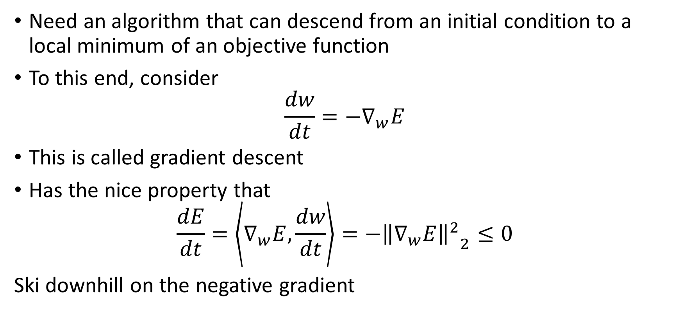
Gradient Descent
Need an algorithm that can descend from an initial condition to a local minimum of an objective function
To this end, consider
$$\frac{dw}{dt}=−∇_{w}E$$
This is called gradient descent
Has the nice property that
$$\frac{dE}{dt}=\left\langle ∇_{w}E,\frac{dw}{dt}\right\rangle =−{{\left\|∇_{w}E\right\|}^{2}}_{2}≤0$$
Ski downhill on the negative gradient

Slide 9
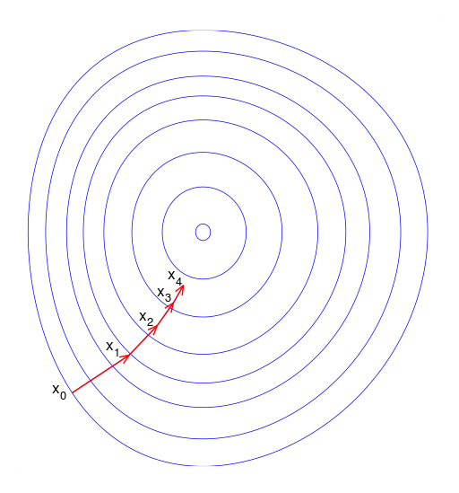
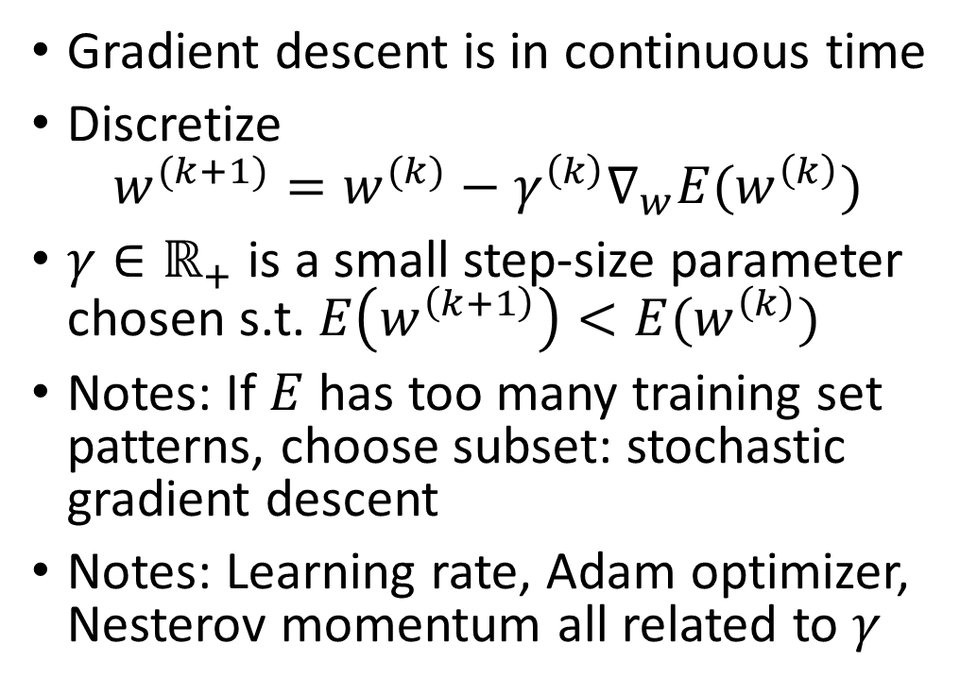

Steepest Descent
Gradient descent is in continuous time
Discretize
$$w^{(k+1)}=w^{(k)}−γ^{\left(k\right)}∇_{w}E(w^{\left(k\right)})$$
$γ∈ℝ_{+}$ is a small step-size parameter chosen s.t. $E\left(w^{\left(k+1\right)}\right)<E(w^{\left(k\right)})$
Notes: If $E$ has too many training set patterns, choose subset: stochastic gradient descent
Notes: Learning rate, Adam optimizer, Nesterov momentum all related to $γ$
Source: Wikipedia. Uses $x$ instead of $w$

Slide 10
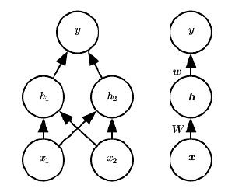


The XOR network
$$h_{1}={\max\left\{0,{W_{11}x}_{1}+W_{12}x_{2}+c_{1}\right\}}_{}$$
$$h_{2}=\max\left\{0,W_{21}x_{1}+W_{22}x_{2}+c_{2}\right\}$$
$$y=w_{1}h_{1}+w_{2}h_{2}+b$$
Note: $W$ and $w$ similar to text but transposed

Slide 11
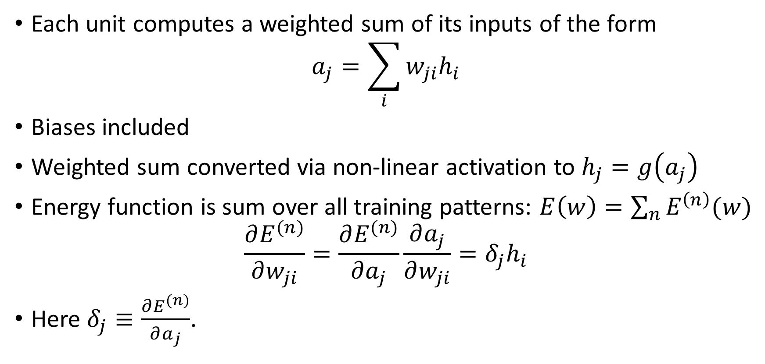
Error backpropagation
Each unit computes a weighted sum of its inputs of the form
$$a_{j}=\sum_{i}{w_{ji}h_{i}}$$
Biases included
Weighted sum converted via non-linear activation to $h_{j}=g\left(a_{j}\right)$
Energy function is sum over all training patterns: $E\left(w\right)=\sum_{n}{E^{\left(n\right)}(w)}$
$$\frac{∂E^{(n)}}{∂w_{ji}}=\frac{∂E^{(n)}}{∂a_{j}}\frac{∂a_{j}}{∂w_{ji}}=δ_{j}h_{i}$$
Here $δ_{j}≡\frac{∂E^{(n)}}{∂a_{j}}$.

Slide 12



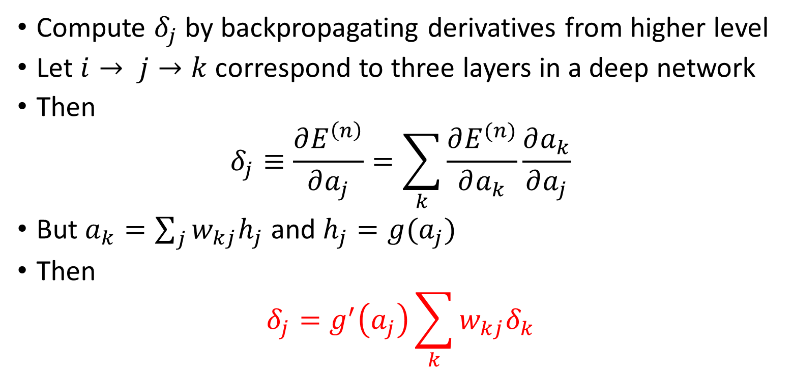




Error backpropagation fini
Compute $δ_{j}$ by backpropagating derivatives from higher level
Let $i→ j→k$ correspond to three layers in a deep network
Then
$$δ_{j}≡\frac{∂E^{\left(n\right)}}{∂a_{j}}=\sum_{k}{\frac{∂E^{(n)}}{∂a_{k}}}\frac{∂a_{k}}{∂a_{j}}$$
But $a_{k}=\sum_{j}{w_{kj}h_{j}}$ and $h_{j}=g(a_{j})$
Then
$$δ_{j}=g^{′}\left(a_{j}\right)\sum_{k}{w_{kj}δ_{k}}$$
$$h_{k}$$
$$a_{k}$$
$$w_{kj}$$
$$h_{j}$$
$$a_{j}$$
$$w_{ji }$$
$$h_{i}$$

Slide 13
Open Source Frameworks
Keras (with back ends TensorFlow, Theano, CNTK): http://keras.io
Example: TensorFlow
Code written in python
Can run in virtualenv, Docker container: Jupyter Notebook
Installation: anaconda (easiest)
Run in browser (Example: google colab)

Slide 14
Keras (on top of TensorFlow)
import numpy as np
import keras
x = np.array([[0,0], [0,1], [1,0], [1,1]])
y = np.array([[0], [1], [1], [0]])
from keras.models import Sequential
from keras.layers import Dense, Activation
from keras.optimizers import SGD
model = Sequential()
model.add(Dense(2, input_shape=(2,)))
model.add(Activation('relu'))
model.add(Dense(1))
model.compile(loss='mean_squared_error', optimizer=keras.optimizers.Adam(), metrics=['accuracy'])
model.fit(x,y, epochs=2000, batch_size=4)
prediction = model.predict(x, verbose=1)
print(prediction)
model.summary()
for layer in model.layers:
print(layer.get_weights())

Slide 15
Running Keras
Epoch 1995/2000
4/4 [==============================] - 0s 2ms/step - loss: 7.5752e-07 - acc: 1.0000
Epoch 1996/2000
4/4 [==============================] - 0s 2ms/step - loss: 7.4497e-07 - acc: 1.0000
Epoch 1997/2000
4/4 [==============================] - 0s 2ms/step - loss: 7.3595e-07 - acc: 1.0000
Epoch 1998/2000
4/4 [==============================] - 0s 2ms/step - loss: 7.2617e-07 - acc: 1.0000
Epoch 1999/2000
4/4 [==============================] - 0s 2ms/step - loss: 7.1675e-07 - acc: 1.0000
Epoch 2000/2000
4/4 [==============================] - 0s 2ms/step - loss: 7.0838e-07 - acc: 1.0000

Slide 16
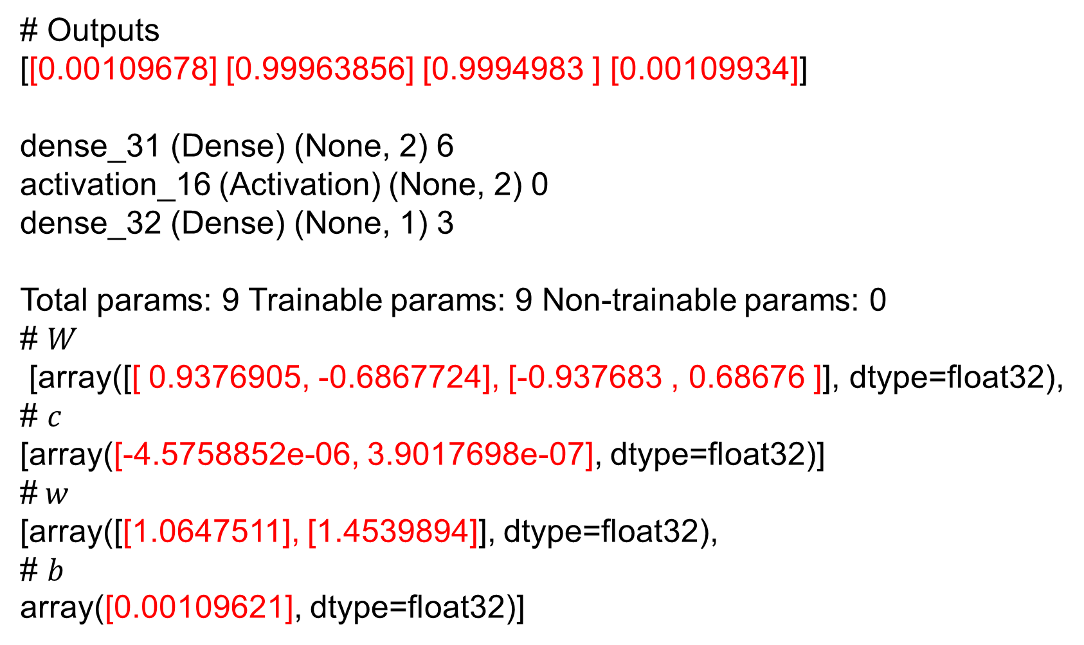
# Outputs
[[0.00109678] [0.99963856] [0.9994983 ] [0.00109934]]
dense_31 (Dense) (None, 2) 6
activation_16 (Activation) (None, 2) 0
dense_32 (Dense) (None, 1) 3
Total params: 9 Trainable params: 9 Non-trainable params: 0
# $W$
[array([[ 0.9376905, -0.6867724], [-0.937683 , 0.68676 ]], dtype=float32),
# $c$
[array([-4.5758852e-06, 3.9017698e-07], dtype=float32)]
#$w$
[array([[1.0647511], [1.4539894]], dtype=float32),
# $b$
array([0.00109621], dtype=float32)]

